Slide 1

Pager Rotation Duties
Faith Siebert
Module 7.2
7/7/24

Slide 2
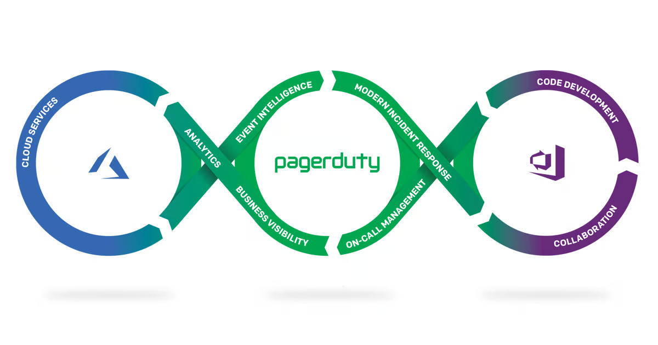
PagerDuty for DevOps
DevOps involves developers supporting the software they deliver throughout its lifecycle, rather than relying solely on an operations team.
PagerDuty provides a platform based on DevOps best practices to minimize downtime and protect the end customer experience.
Developers can optimize workflows, streamline issue resolution, and focus on building and innovating.

Slide 3
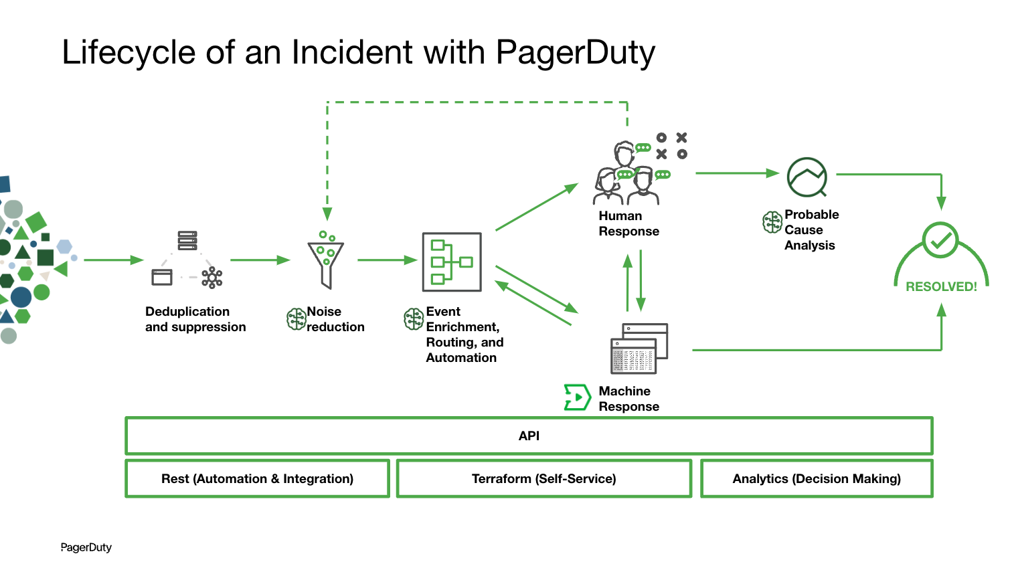
Sharing Pager Rotation Duties
Developers share pager rotation duties with operations teams.
Immediate feedback about application performance helps developers.
Ops receive active support from colleagues in resolving code-related production issues.

Slide 4
Rotating DRI Role
The primary and secondary DRI (Directly Responsible Individual) roles rotate across team members.
Seamless transitions occur, with the secondary DRI becoming the primary DRI in the next rotation.
Rotation cadence is typically two weeks, aligning with sprint cycles.

Slide 5
On-Call Rotations in DevOps
With DevOps, engineers participate in on-call rotations (previously an ops responsibility).
Carrying the pager (often with off-hours requirements) is a shared task among team members.

Slide 6
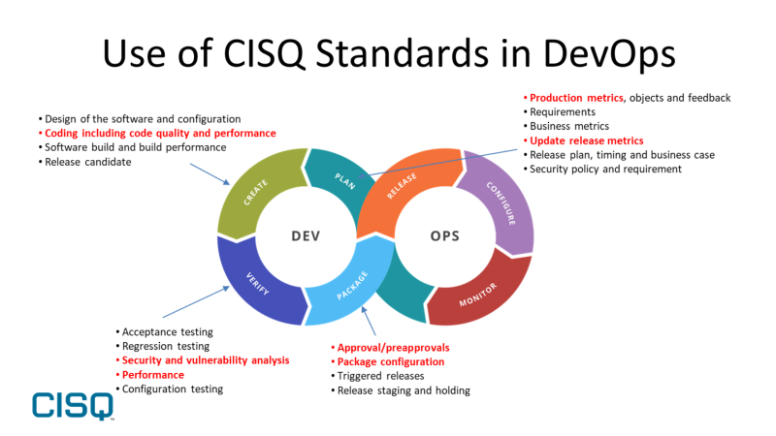
Incident Response Process
When an incident occurs (service outage, performance degradation), the on-call engineer (pager) is alerted.
The on-call engineer investigates, troubleshoots, and resolves the issue.
If necessary, they escalate to other team members or engage external support.

Slide 7
Escalation Policies
Teams define escalation policies to ensure timely responses.
These policies specify how alerts escalate from one engineer to another.
Escalation paths may involve different levels of expertise or management approval.

Slide 8
Monitoring and Alerting Tools
Effective pager rotation relies on robust monitoring and alerting systems.
Engineers set up thresholds, triggers, and notifications for critical metrics.
PagerDuty, OpsGenie, and other tools help manage alerts and rotations.

Slide 9
Sources
PagerDuty for DevOps. (n.d.). PagerDuty. Retrieved July 7, 2024, from https://www.pagerduty.com/resources/solutions-brief/pagerduty-for-devops/
staff, I. T. (2023, February 21). Rotating DevOps role improves engineering service quality. Inside Track Blog. https://www.microsoft.com/insidetrack/blog/rotating-devops-role-improves-engineering-service-quality/
Skoczny, D. (2019, April 7). The Three Ways: The princeples of feedback - Daniel Skoczny - Medium. Medium; Medium. https://medium.com/@DSkoczny/the-three-ways-the-princeples-of-feedback-9aff3f708b5b
‌

